Slide 1

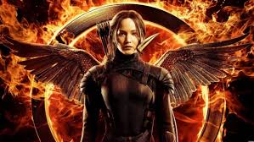
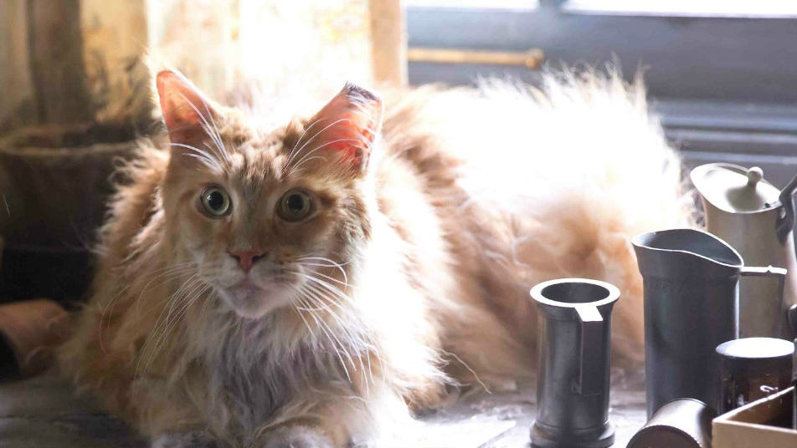
The Relation Between Katniss and Buttercup
April 17,2025
NhanNgocThach – For Educational Use Only
Katniss” The Mockingjay”
Buttercup” The ugliest cat”
Notes:
Hello. Today I’m going to talk about the relation between Katniss and Buttercup — a girl and a cat who change more than we expect. In The Hunger Games, there are many big moments: war, survival, love, rebellion. But today I want to focus on something smaller …->this quiet relationship. When we think about Katniss, we think about bravery and strength. And when we think about Buttercup, we think about a ugliest cat. But together, these two characters show us something emotional — how pain and loss can bring even enemies together. Their story is not loud or romantic. It’s slow and silent. But that makes it even more meaningful.

Slide 2

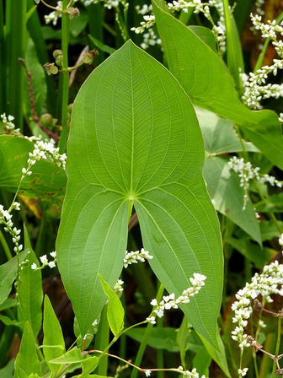
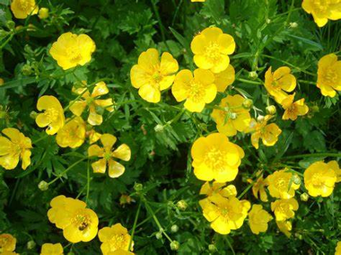

Overview of Katniss and Buttercup
NhanNgocThach – For Educational Use Only
Notes:
First, the fact that both Katniss and Buttercup are the names of wildflowers? -- Katniss is a real plant that grows in water. It’s strong and sharp, just like Katniss Everdeen. --Buttercups are small yellow flowers. They look soft, but they can survive in many places. Even from the beginning, their names tell us something. They are natural, quiet, and strong in different ways. In the story, Katniss is the protector of her family. She hunts, fights, and takes care of Prim. Buttercup is Prim’s cat. He is rude, makes ugly sounds, always growl to Katniss, and Katniss hates him. But even though they seem far apart, they are connected — by Prim, and by what they both go through.

Slide 3


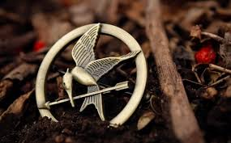
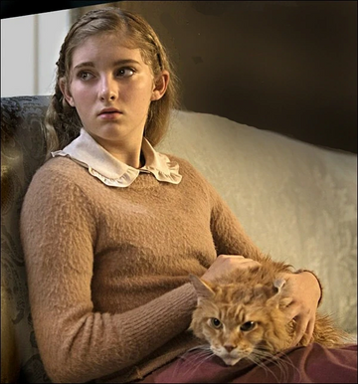
What the Cat and Katniss Represent
NhanNgocThach – For Educational Use Only
Survival and Strength
Loyalty and Compassion
Notes:
On this slide, we can see what Katniss and Buttercup represent what they stand for in the story.
Katniss is the Mockingjay, a symbol of rebellion and strength. She fights in the Hunger Games, protects her family, and never gives up — even when she is scared or hurt.
Buttercup may be just a cat, but he represents something powerful too -> loyalty and compassion, especially with Prim. He stays with her, and after Prim dies, he comes back to look for her.
These two are very different. But when they sit together at the end — after everything they’ve lost — they share something deeper. Their bond becomes a quiet way to show love, pain, and healing.
Together, they show us that even the strongest people need someone. And even the quietest animals can give comfort.

Slide 4

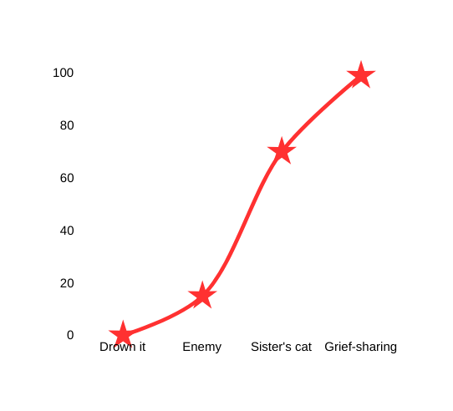

Their Relationship Changes
NhanNgocThach – For Educational Use Only
Notes:
Let’s look at how their relationship changes.
At the beginning, Katniss hates Buttercup. She says, “The last thing I needed was another mouth to feed.” She even tried to drown him. That’s the lowest point.
Later, she accepts him — but only because Prim loves him. She still calls him ugly and mean. She doesn’t care about him.
But after Prim dies, everything changes.
Buttercup comes home, crying for Prim. And Katniss suddenly realizes — they are the only two who truly loved her. That shared pain becomes a connection.
Their relationship moves from hate, to ignoring, to quiet understanding — all because of Prim.

Slide 5


They Both Lost Prim
""I fall on my knees, fists clenched, and I'm sobbing into his fur. But he only sits there, hating me, watching."
NhanNgocThach – For Educational Use Only
Notes:
In the last chapter of Mockingjay, Katniss is finally home in District 12. She’s lost almost everything — her friends, her home, and her sister.
Then Buttercup comes back. He’s dirty, hurt, and still alive. He meows, searching for Prim.
Katniss gets angry. She throws a cup at him. But then, she collapses and cries.
She says: “I fall on my knees, fists clenched, and I'm sobbing into his fur. But he only sits there, hating me, watching.”
This line shows everything. They don’t hug. They don’t talk. But they both feel the same loss. That’s their connection — grief, not love.
They are two survivors in pain. Sitting together. And that’s more powerful than words.

Slide 6


A Moment of Pain and Connection
NhanNgocThach – For Educational Use Only
Notes:
Let’s watch the video of that moment.
In the scene, Buttercup waiting for prim. He seem like crying. He wants Prim.
Katniss is silent. Then she breaks down. She falls to the ground and cries into his fur.
This moment is powerful and this is where their relationship becomes real.
It’s not about friendship or forgiveness.
It’s about two survivors who both lost the same person — Prim. They do not become friends. But they finally understand each other.
Sometimes, the strongest relationships are the quietest. This is not about friendship. It’s about survival, and shared grief.

Slide 7
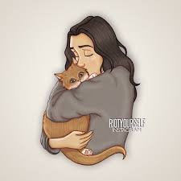
Last Thoughts
NhanNgocThach – For Educational Use Only
Notes:
So, what is the relationship between Katniss and Buttercup?
It starts with hate. It becomes quiet. It ends with pain — but also connection.
They don’t need to like each other. They don’t need to speak. But in the end, they understand each other.
This relationship shows us that even two different souls — a girl and a cat — can share something deep through grief.

Slide 8

NhanNgocThach – For Educational Use Only
Nhan Ngoc Thach

